Slide 1

Quora Question Pair Competition
Team12: Bo Pan, Lian Xinyu, Yichen Lu, Shuhong Xiao, Zhongbo Zhu

Slide 2

Task Problem

Slide 3
What we have used: - Models: LSTM, CNN, MLP, XGBOOST - Features: 90 traditional features + features extracted by CNN+LSTM - Model Ensemble: Voting, Stacking - Tricks: Swap Q1&Q2 (more data), Magic features, Post-processing - Finally, Kaggle Submission Rank 279/3295

Slide 4
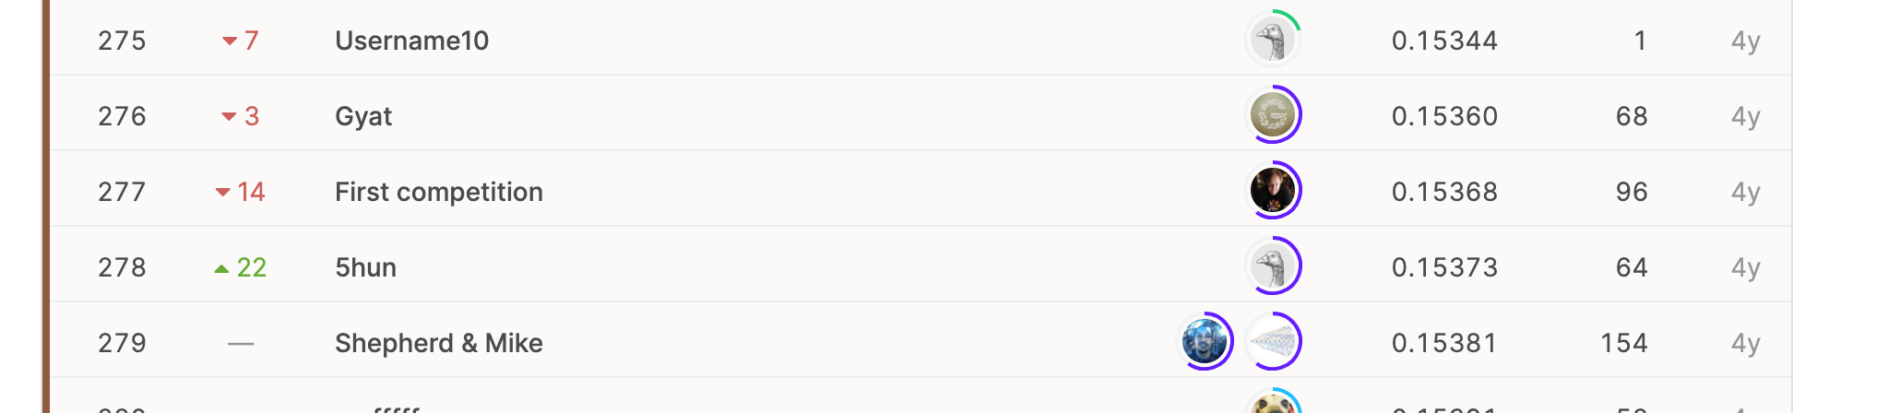

Final Result (Bronze Medal )
Rank 279 Among 3296
competitors

Slide 5
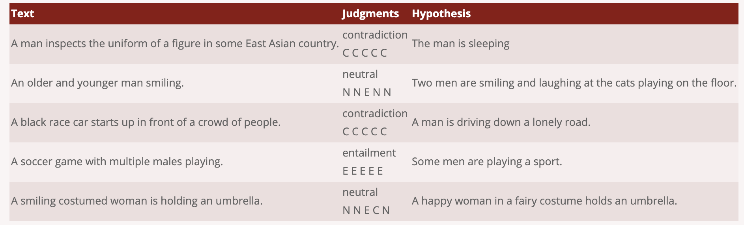
Literature review :

Slide 6
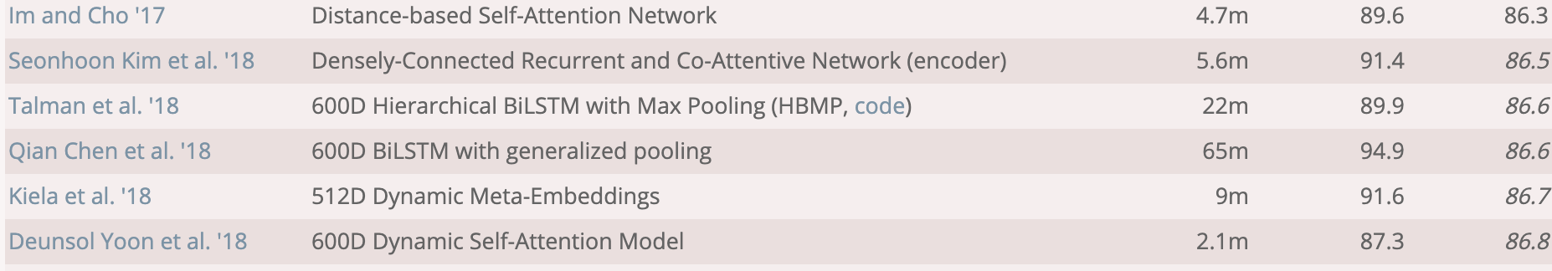
Literature review :

Slide 7
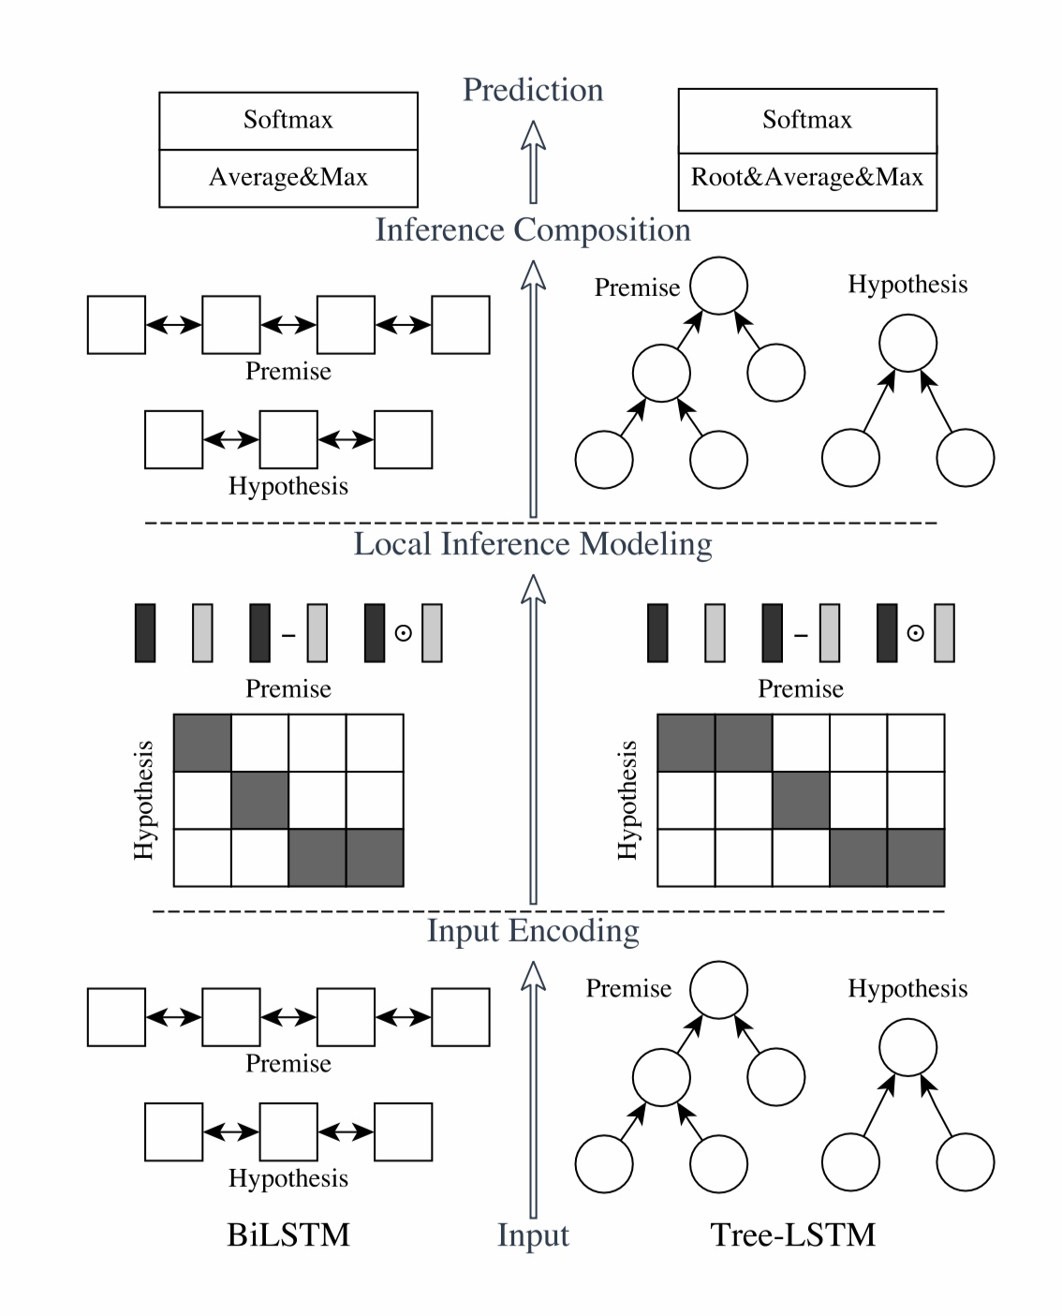

Literature review :

Slide 8
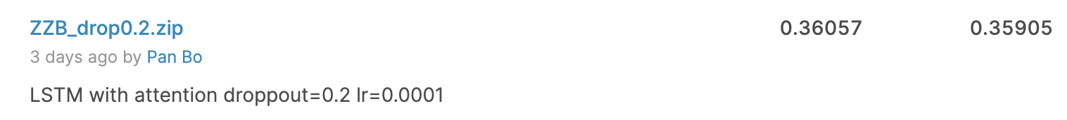
1. Cut off half of the model 2. Change the model from asymmetric to symmetric 3. reduce dimension to 300D for word and 30D for sentence
Accuracy 83% on our held-out test set

Slide 9

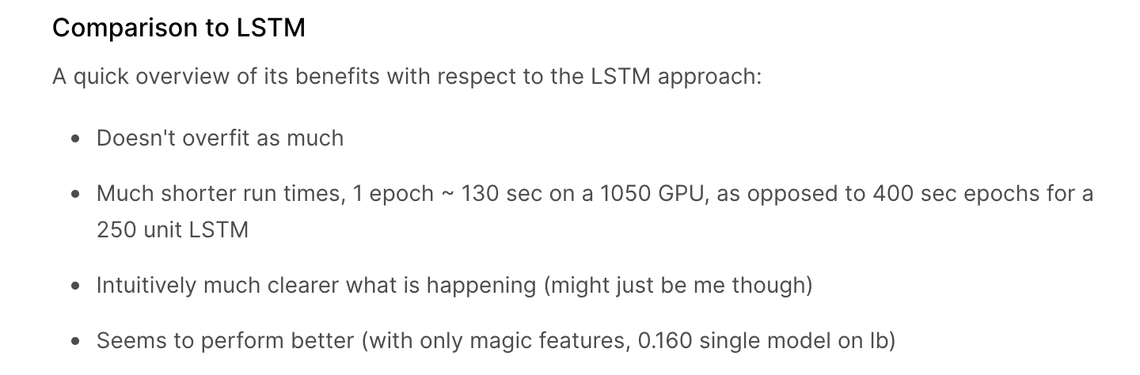
Literature review :

Slide 10
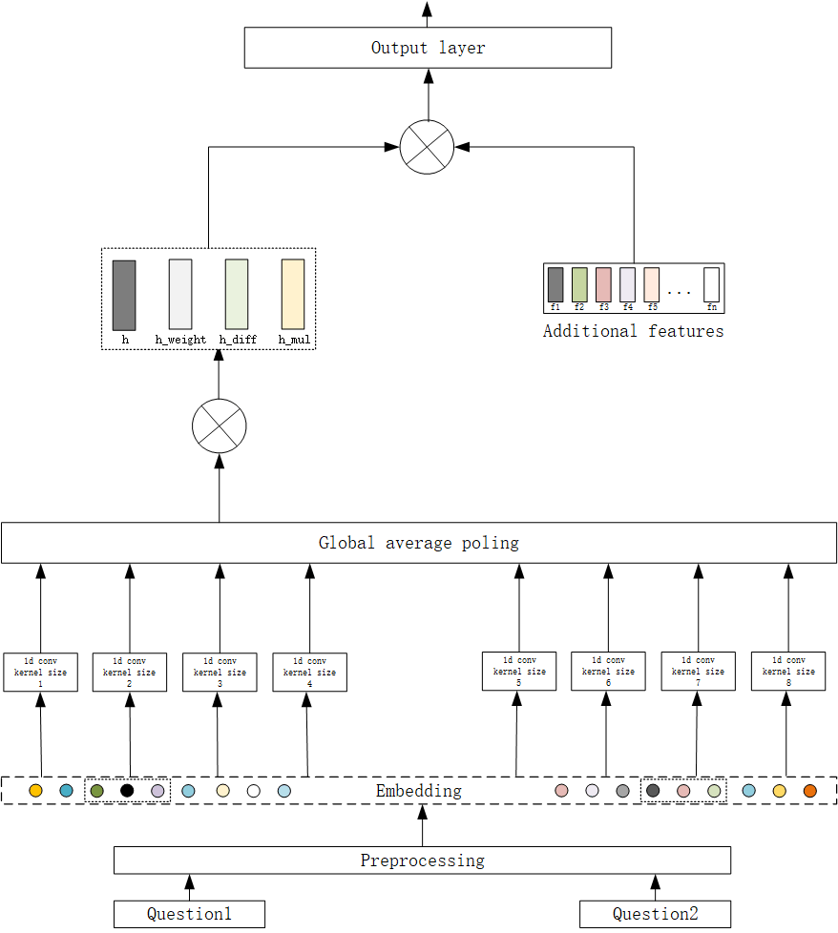

Accuracy 85% on our held-out test set
1. Use conv kernel with length from 1-8
Instead of 1-6.
2. Borrow the design from our LSTM for the
Latter layer.

Slide 11
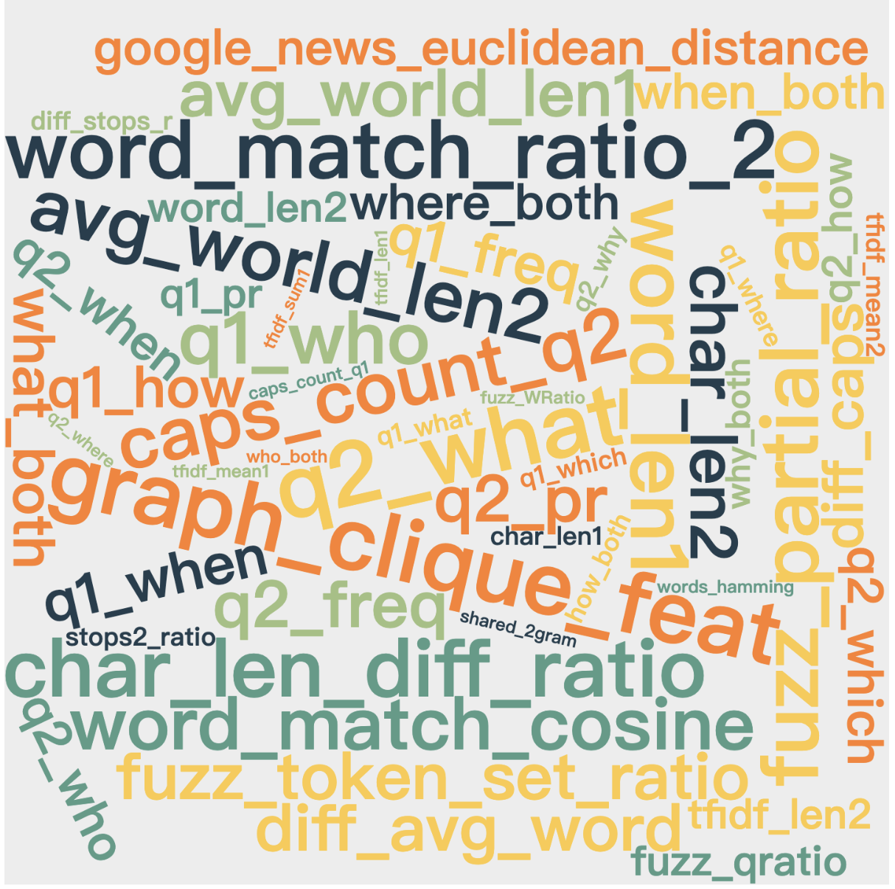
Feature Engineering
We collect almost all the traditional features we can find on the Kaggle forum (90+).
We also use LSTM&CNN to automatically extract features from the raw inputs.
The impact of “which feature we choose” is much larger than “which model we choose”.

Slide 12
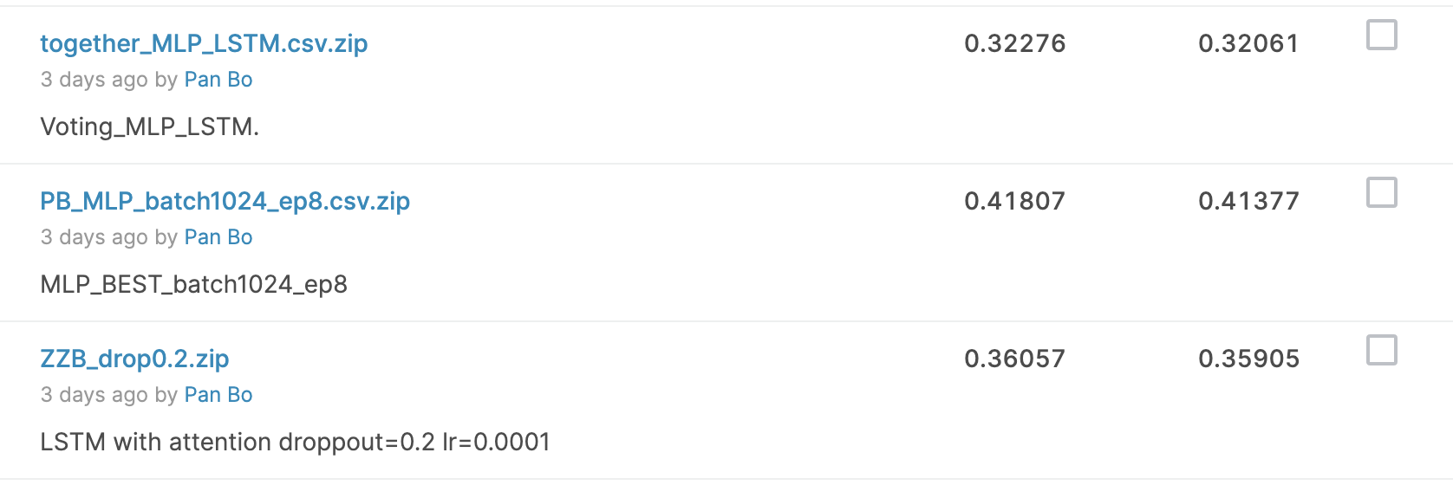
Model Ensemble: Voting Simple but extremely useful, especially when score is not too high.

Slide 13
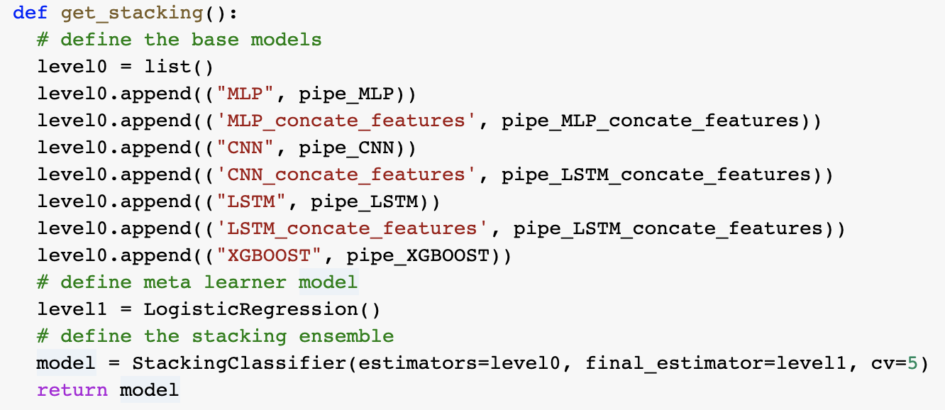
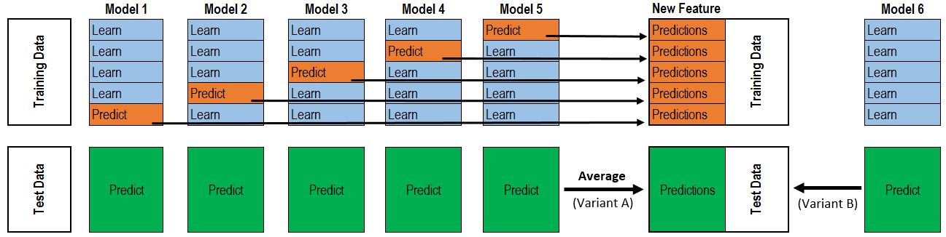
Model Ensemble: Stacking two-layer-stacking-model

Slide 14
CNN based model CNN in NLP?
Use filter to scan across the words, not the word embeddings
Filter is 1D filter, which produces inner product between filter and embedding tensor
Input dim is (30,300), use 128 filters, with filter size 5, we have output to be (30-5+1,128)
Pooling Layer picks average/max value along the axis of words

Slide 15
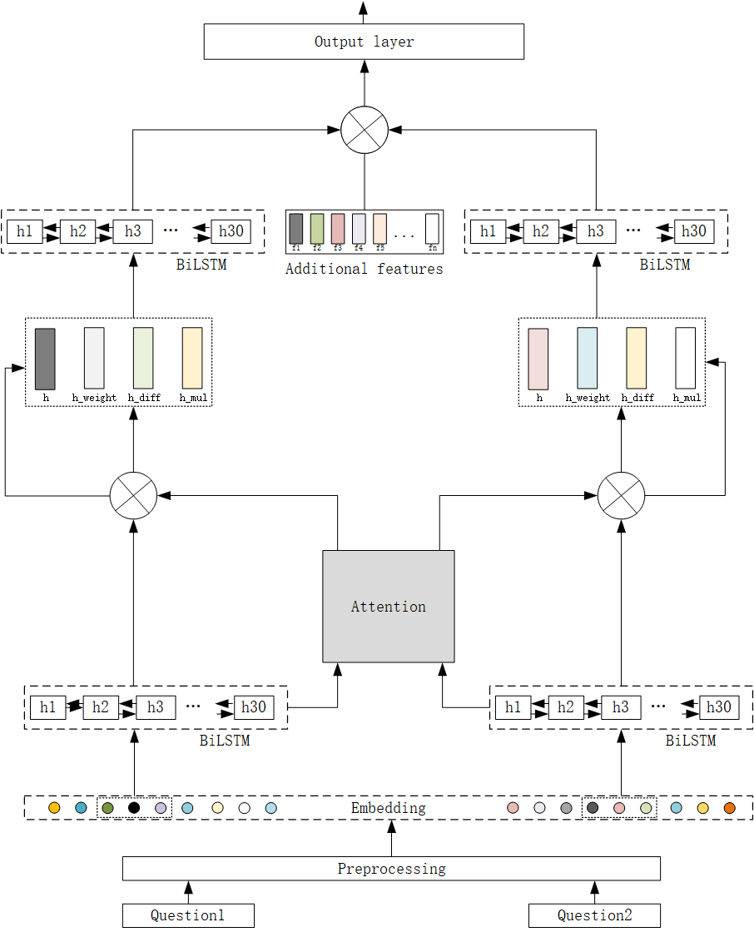
Bidirectional LSTM model
Double Layer of Bi-LSTM
Attention between two hidden states produced by LSTM
Feature input at the beginning of fully connected layer
Glove Embedding + One Dense Layer for tuning
At second Bi-LSTM, stacking attention output, previous hidden states, and their subtracted/multiplied result together

Slide 16
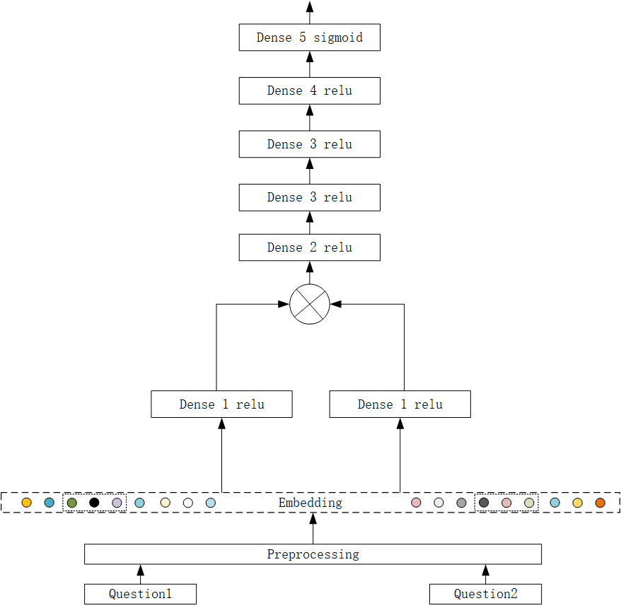
MLP model Simple but useful
Dense layer after dense layer… Finally reduce to binary classification
Also add extra features in fully connected layer for future classification
For this model and CNN/LSTM, We use drop out and batch normalization for nearly all the dense layers

Slide 17
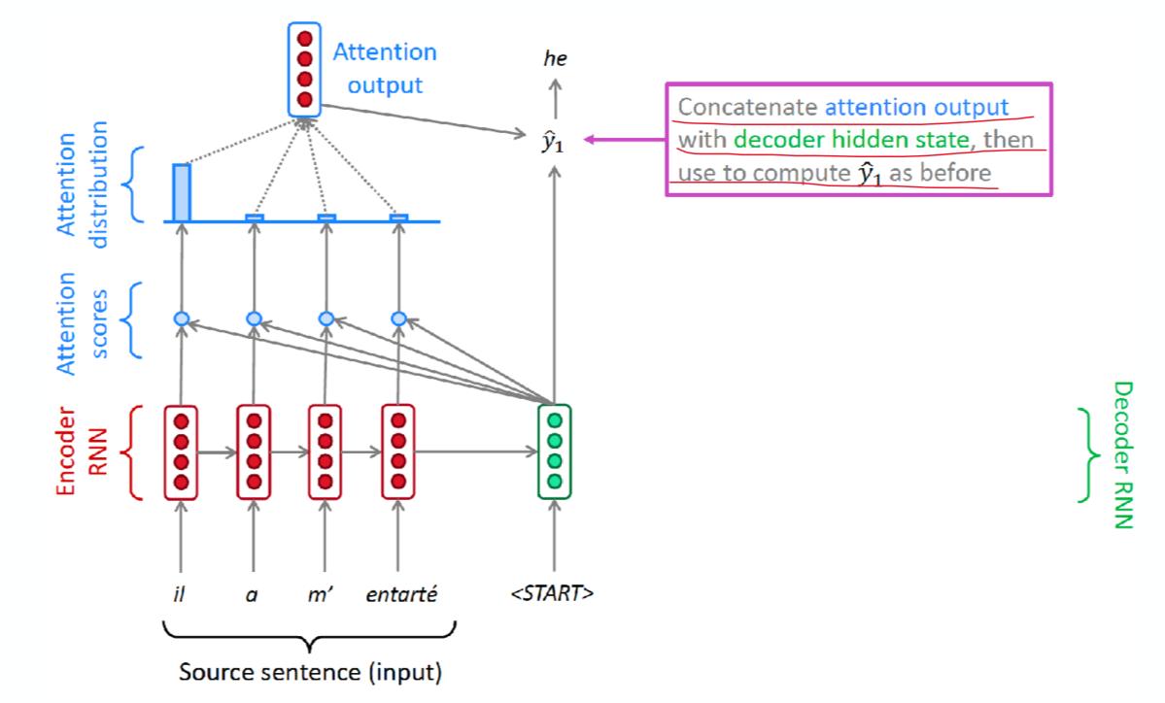
Attention Layer Example
“I played games then.”
“Games played by me”
How will the attention layer help in the LSTM model?
Remember that vector of same direction has larger value of inner product, so its softmax output is closer to 1
There are two questions from Quora, denote them as A and B
When we want to add attention info. to hidden states of LSTM to question B, we are letting A to be encoder, and B to be decoder. When we want to add attention to A, just let A be to decoder and B as encoder
Then everything get reduced to language translation model from class

Slide 18
Model Performance After Getting Features Classic Model Never Dies!
 | Loss | Accuracy | Loss(feature) | Accuracy(feature)
MLP | 0.46 | 0.81 | 0.23 | 0.891
CNN | 0.37 | 0.82 | 0.24 | 0.893
Enhanced LSTM | 0.36 | 0.815 | 0.23 | 0.895
Final best model (+ XGBoost) | None | None | 0.15 | 0.931

Slide 19
Conclusion & Analysis:
Quora questions are like very short questions, maybe we don’t need LSTM to grab long short-term memory because:
“How do you think of Donald Trump?”
“What’s your opinion about Donald Trump”
These questions are short, and the key words like “Donald Trump” are way more important than the other words like “your opinion”. There are so many questions that begins with “What do you think of”, there is totally no need for model to grab these trivial sentence structure
Long sentences classification that needs model’s attention across the whole structure, maybe that’s where CNN and RNN would perform better…

Slide 20
Conclusion & Analysis:
The training set is not large and diverse enough for strong models like CNN and LSTM + Attention to fit, MLP works just as well
Bidirectional LSTM didn’t contribute much, because again, Quora question never needs huge focus on overall structure of sentences
We think that the attention mechanism here is like focusing only on the key words, but this task can also be achieved by MLP because there is not much to pay attention

Slide 21

THANKS

